Slide 1
Smartphone GPS Duty-Cycle for Saving Battery in Navigation
Matthew Borbonus, Stephen Marhefka

Slide 2
PROJECT OVERVIEW
Algorithmically turn on and off the GPS unit in an attempt to reduce power consumption
Create a proof of concept implementation to run tests/measure power utilization to determine the degree of energy savings

Slide 3
PROGRESS
Wrangle control of GPS unit...DONE
Obtain users location & velocity...DONE
Design algorithm to control GPS given velocity and remaining travel distance...UNDERWAY
Perform testing of efficacy of algorithm...NOT STARTED
Measure power savings (if any) of algorithm...NOT STARTED

Slide 4
CHANGES TO PLAN
Using power meter to measure power consumption rather than using system calls/other on-device methods
Potentially using static (premade) routes rather than routes generated by Google Maps/other services

Slide 5
OUR (HOPEFUL) FINAL PRODUCT
A workable proof of concept algorithm
Running on a rooted Android device
Able to modulate GPS power state while simultaneously reducing power and guaranteeing a user won’t miss a turn
Create an algorithm that can be ported to established navigation systems

Slide 6
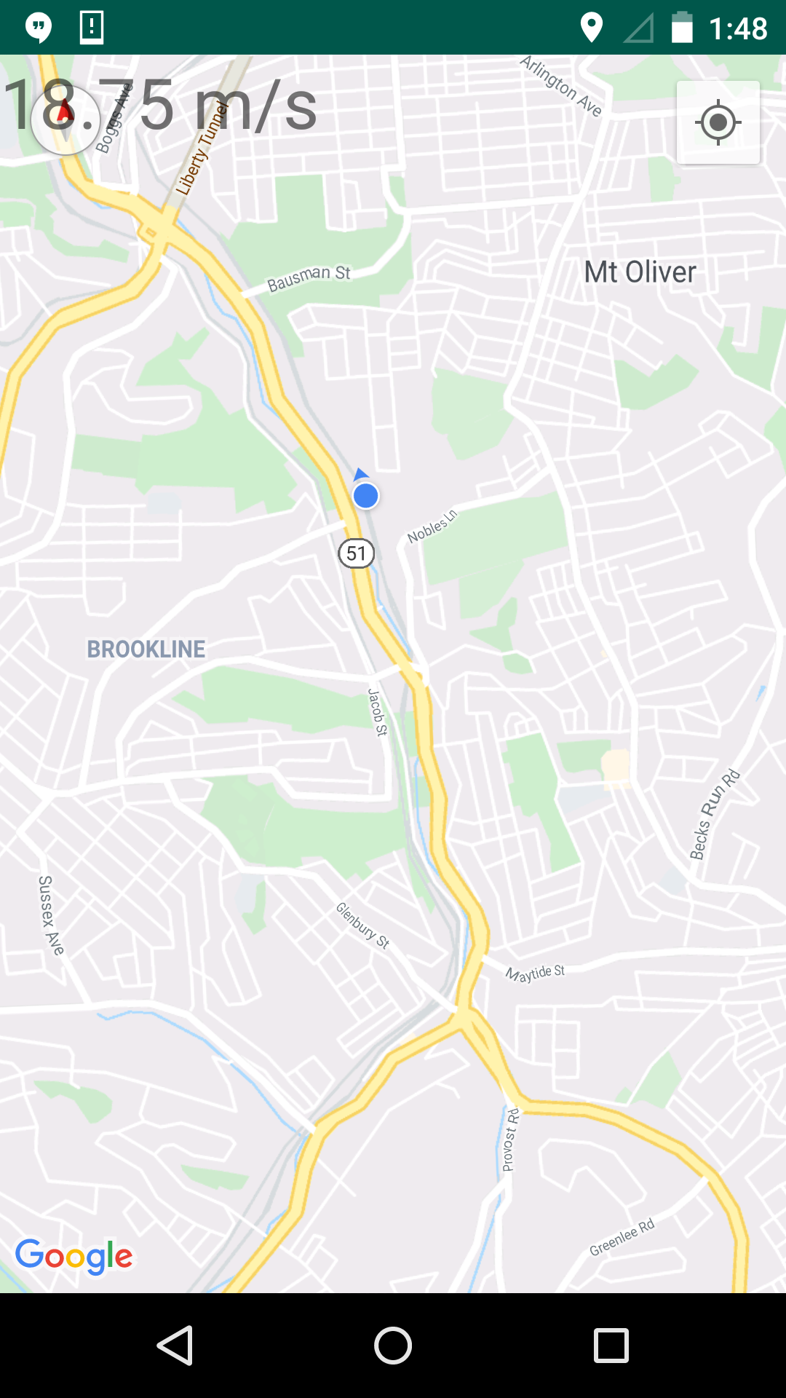
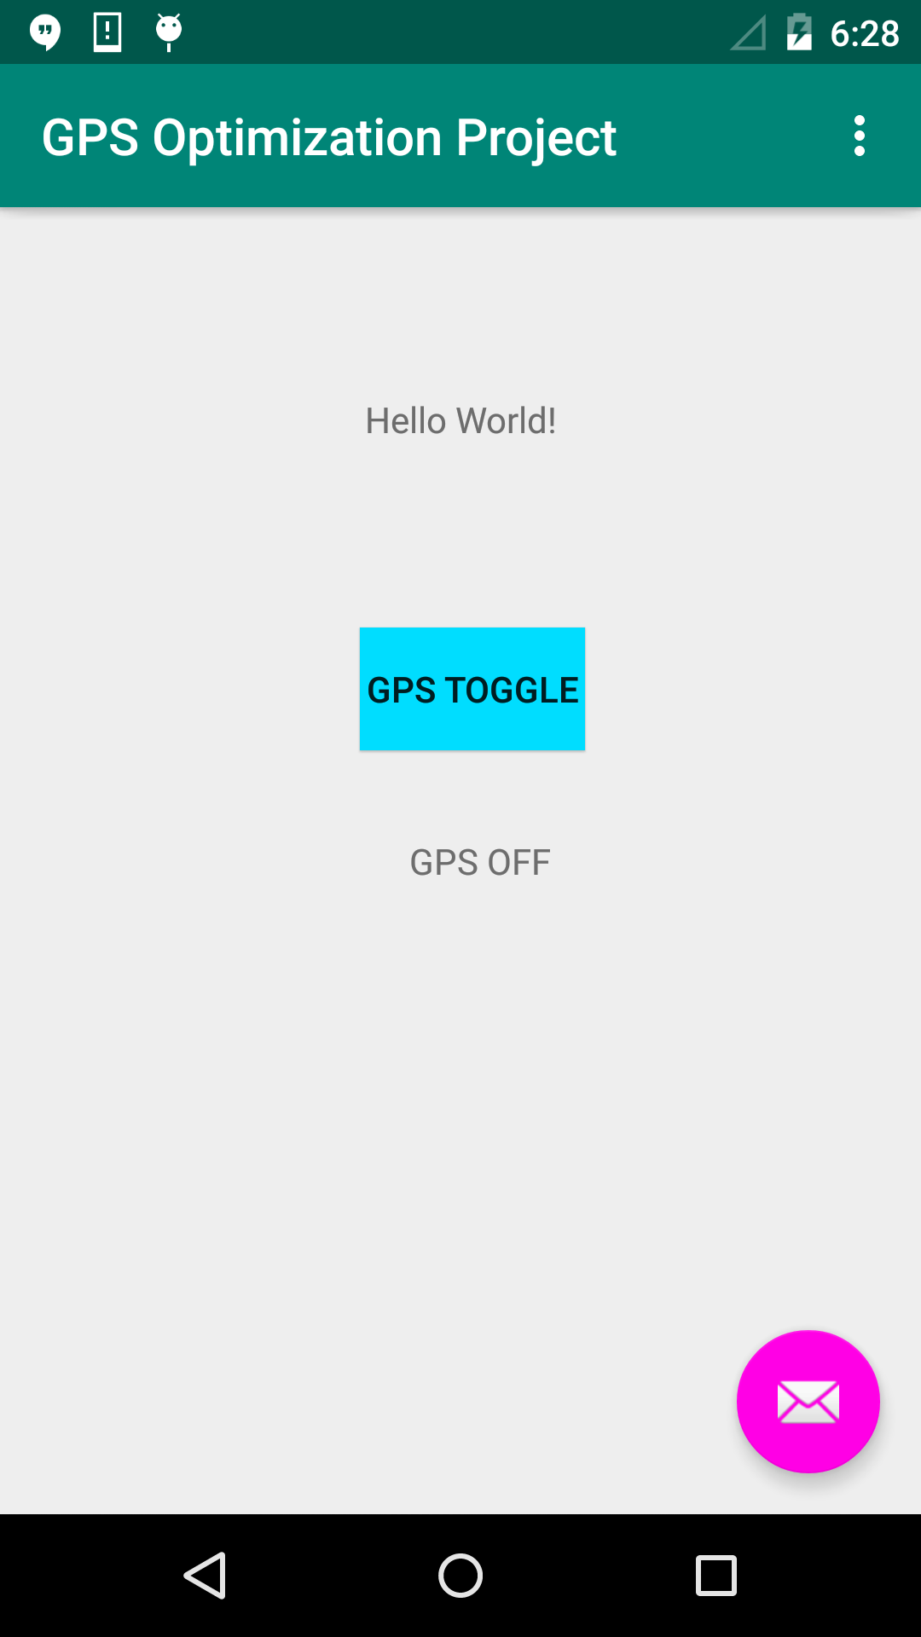

Slide 7
